Slide 1
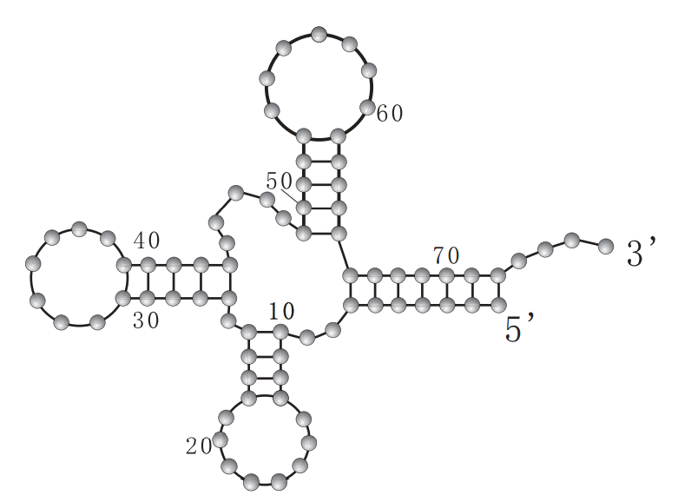
Chapter 6
RNA Folding Problem
Sample RNA Sequence
s = GCCAUUGAUGACCUGAGCGGGAUGGCCCAAGU
A single linear RNA sequence is to be folded in such a way that
it facilitate maximum number of pairing(hydrogen bonds) between
{A,U} and (C,G) pair .
If A come near to U, it automatically bond . Similarly, C and G. But the molecular chain need to bend itself so that A is closer to U and C is closer to G. Like in humans, maximum only one pairing is allowed for any nucleotide
In the figure, 76 nucleotide long linear RNA sequence is folded
to form a structure. It can be folded in several ways. We need to find
the one with maximum number of bonds between AU and CG pairs

Slide 2
RNA Folding Problem
The RNA-folding problem is to predict the secondary structure of an RNA molecule, given only its nucleotide sequence. This important, classic problem in computational biology is often solved with variants of dynamic programming that have been highly refined and engineered in several widely used computer programs. But here, we show how integer linear programming can be used to obtain the same results, with much less effort on the part of the developer or programmer, and can also be extended to model more complex versions of the folding problem, in ways that are difficult to model with dynamic programming

Slide 3
RNA Folding Problem
We lets denote a string of n characters made up of the RNA alphabet{A, C, U, G}. For example, s = ACGUGCCACGAU. We define a pairing as set of disjoint pairs of characters in s. The word “disjoint” here means that a character cannot be in more than one pair. Note that some characters might not be in any pair in a pairing. A pair that is in a pairing is said to be a matched pair. A pair is called complementary if the two characters in the pair are {A,U} or {C,G}. A pairing is called complementary if all of the matched pairs in the pairing are complementary

Slide 4
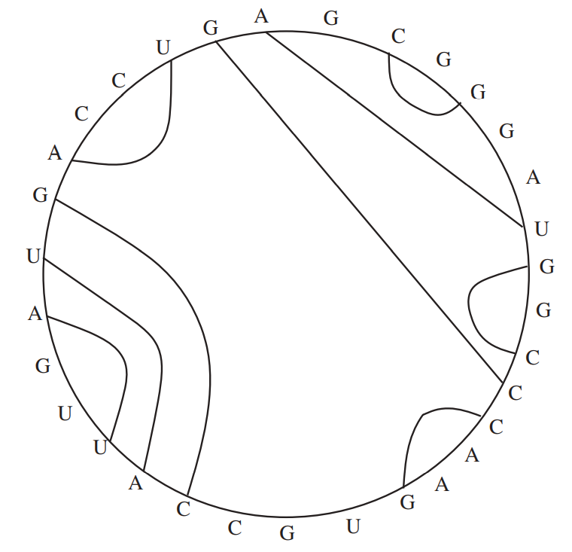
Nested Pairing
Circular View
Sequence s = GCCAUUGAUGACCUGAGCGGGAUGGCCCAAGU

Slide 5
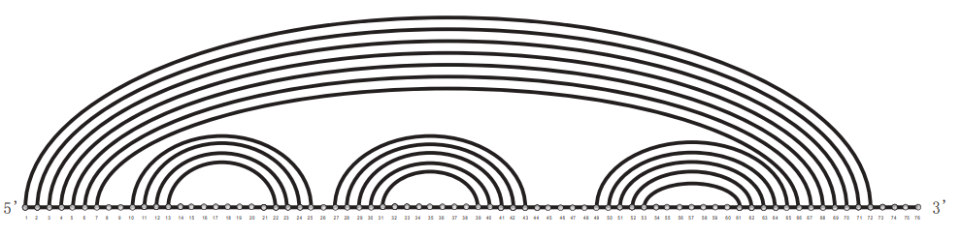
Nested Pairing-Linear view

Slide 6
Formulation
1
The Variables The ILP formulation for the simple RNA-folding problem will have one binary variable, called P(i, j), for each pair (i, j) of positions in s, where i < j. The value of P(i, j) given by a feasible solution to the ILP formulation will indicate whether or not the nucleotide in position i of s will be paired with the nucleotide in position j of s. If P(i, j) is assigned the value 1, then the nucleotide in position i will be paired with the nucleotide in position j. If it is assigned the value 0, then those two nucleotides will not be paired.

Slide 7

Formulation
2
The Inequalities The first constraint we implement in the ILP formulation is the requirement that any pairing must be complementary. So, if the ordered pair of nucleotides in any two positions, i and j, are not one of (A, U) or (U, A) or (C, G) or (G, C), then the formulation will include the equality:
to disallow the pairing of the nucleotides in positions i and j

Slide 8
Exercise
Write all the constraint of the type P(i,j)=0
for the sequence using rule 1.
s = GCCAUUGAUGACCUGAGCGGGAUGGCCCAAGU
Rule 1:
If the ordered pair of nucleotides in any two positions, i and j, are not one of (A, U) or (U, A) or (C, G) or (G, C), then the formulation will include the equality:

Slide 9
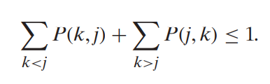
Formulation
3
Next, we implement the requirement that each nucleotide can be paired to at most one other nucleotide. For each position j in s, the ILP formulation will have the inequality:
Rule 2
Jth element can pair at most with one on its left or one on its right position.
<=1 indicate that , pairing is not compulsory

Slide 10
Exercise
Write the constraint for the second G
based on Rule 2
s = GCCAUUGAUGACCUGAGCGGGAUGGCCCAAGU
For each position j in s

Slide 11
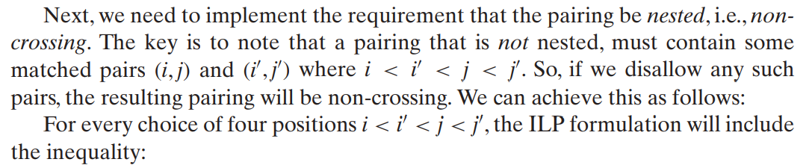

Formulation
Rule 3
Rule 3 prohibits Following simultaneous pairing

Slide 12
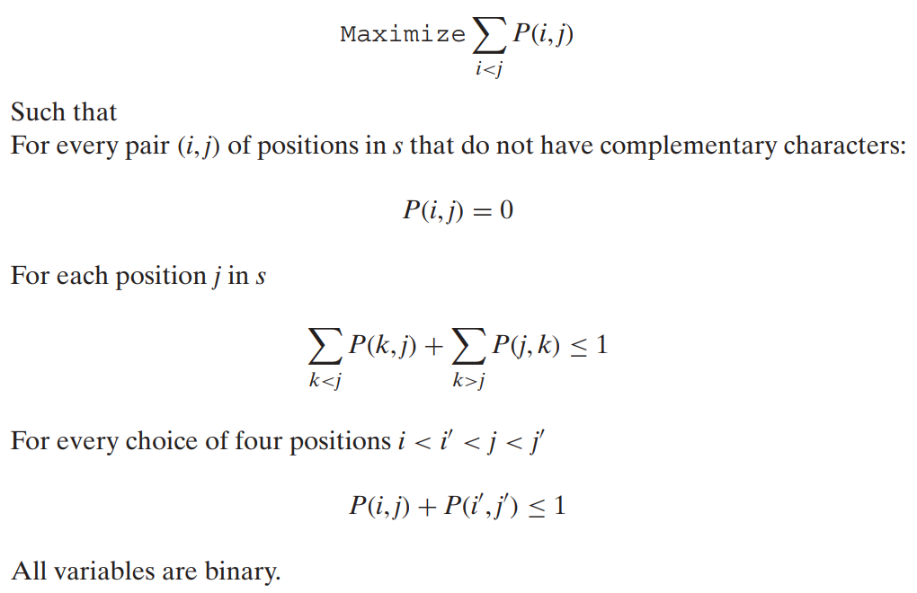
RNA Folding ILP formulation
Maximize the number of bonds

Slide 13
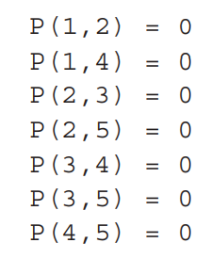
A Toy Example
Consider the short RNA sequence s = ACUGU. The following is the set of equalities that guarantee that the pairing is complementary:
s = ACUGU.
1 2 3 4 5
Rule 1:
If the ordered pair of nucleotides in any two positions, i and j, are not one of (A, U) or (U, A) or (C, G) or (G, C), then the formulation will include the equality: P(i,j)=0

Slide 14
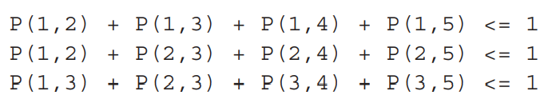

Formulation
s = ACUGU.
1 2 3 4 5
Rule 2
For each position j in s

Slide 15
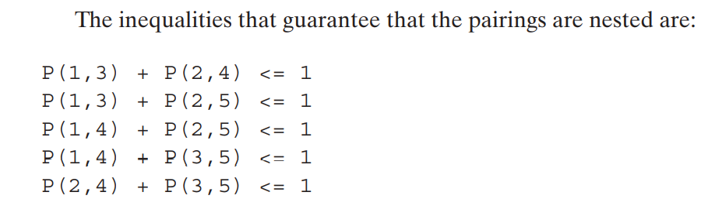
s = ACUGU.
1 2 3 4 5
Rule 3 prohibits Following simultaneous pairing

Slide 16
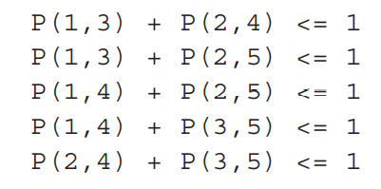
Formulation
Finally, the objective function is: Maximize P(1, 2)+P(1, 3)+P(1, 4)+P(1, 5)+P(2, 3)+P(2, 4)+P(2, 5)+P(3, 4)+P(3, 5)+P(4, 5)
Rule 1
Rule 3
Rule 2

Slide 17
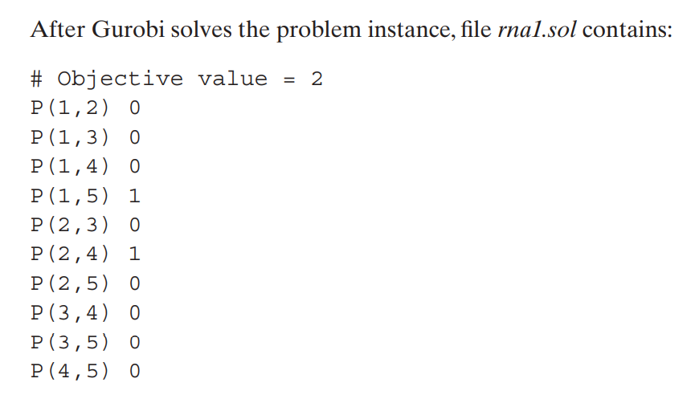

Slide 18
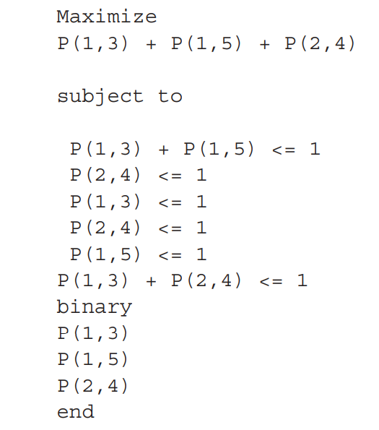
Simplified Version
s = ACUGU.
1 2 3 4 5

